Slide 1
Programming With C++/R
DST102TC
Huakang Li
Huakang.li@xjtlu.edu.cn
School of AI and Advanced Computing
Notes:
English Title: Uppercase, Calibri size 60, XJTLU Navy
English Subtitle: Uppercase, Calibri size 36, XJTLU Navy

Slide 2
Chapter 15
Inheritance and Polymorphism
Notes:
English Title: Uppercase, Calibri size 60, XJTLU Navy
English Subtitle: Uppercase, Calibri size 36, XJTLU Navy

Slide 3
Objectives
To define a derived class from a base class through inheritance (§15.2).
To enable generic programming by passing objects of a derived type to a parameter of a base class type (§15.3).
To know how to invoke the base class’s constructors with arguments (§15.4.1).
To understand constructor and destructor chaining (§15.4.2).
To redefine functions in the derived class (§15.5).
To distinguish between redefining and overloading functions (§15.5).
To define generic functions using polymorphism (§15.6).
To enable dynamic binding using virtual functions (§15.7).
To distinguish between redefining and overriding functions (§15.7).
To distinguish between static matching and dynamic binding (§15.7).
To override virtual functions using the override keyword and use the final keyword to prevent further overriding (§15.8).
To access protected members of a base class from derived classes (§15.9).
To define abstract classes with pure virtual functions (§15.10).
To cast an object of a base class type to a derived type using the static_cast and dynamic_cast operators and know the differences between the two operators (§15.11).

Slide 4
Base Classes and Derived Classes

Slide 5
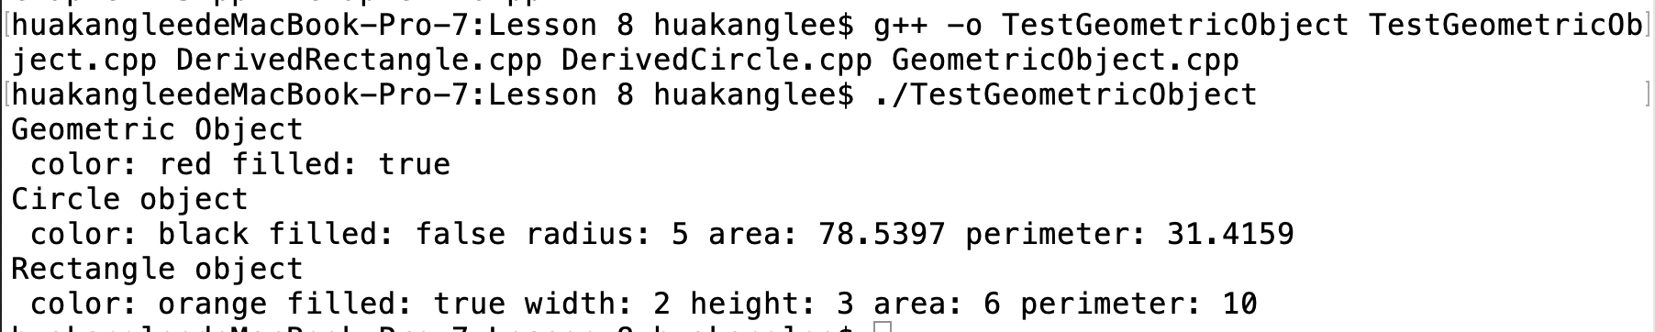
TestGeometricObject
GeometricObject.h
GeometricObject.cpp
DerivedCircle.h
DerivedCircle.cpp
DerivedRectangle.h
DerivedRectangle.cpp

Slide 6
Generic Programming
An object of a derived class can be used wherever an object of a based type is required. This enables a function to be used generically for a wide range of object arguments.
This is known as generic programming. If a function’s parameter type is a base class (e.g., GeometricObject), you may pass an object to this function of any of the parameter’s derived classes (e.g., Circle or Rectangle).

Slide 7
Calling Base Class Constructors
A constructor is used to construct an instance of a class. Unlike data fields and functions, the constructors of a base class are not inherited in the derived class. They can only be invoked (explicitly or implicitly) from the constructors of the derived classes to initialize the data fields in the base class. The syntax to invoke it is as follows:
DerivedClass(parameterList): BaseClass()
{
// Perform initialization
}
Or
DerivedClass(parameterList): BaseClass(argumentList)
{
// Perform initialization
}

Slide 8
No-Arg Constructor in Base Class
A constructor in a derived class must always invoke a constructor in its base class. If a base constructor is not invoked explicitly, the base class’s no-arg constructor is invoked by default. For example,

Slide 9
Constructor and Destructor Chaining
Constructing an instance of a class invokes the constructors of all the base classes along the inheritance chain.
A base class’s constructor is called before the derived class’s constructor.
Conversely, the destructors are automatically invoked in reverse order, with the derived class’s destructor invoked first. This is called constructor and destructor chaining.

Slide 10
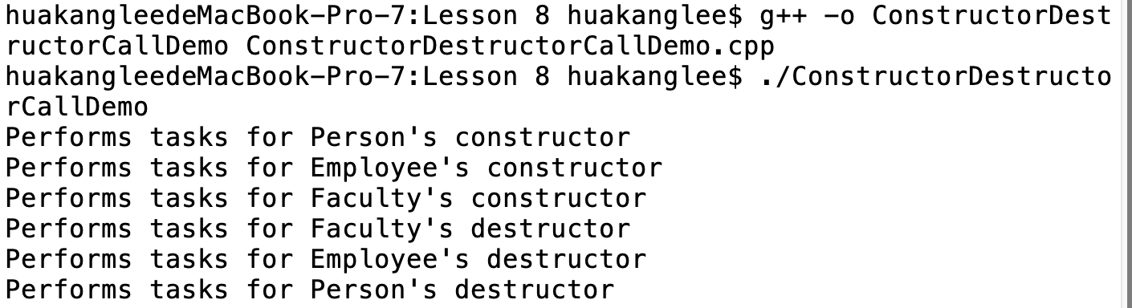
ConstructorDestructorCallDemo.cpp
class Employee: public Person
{
public:
Employee() {
cout << "Performs tasks for Employee's constructor" << endl;
}
~Employee() {
cout << "Performs tasks for Employee's destructor" << endl;
}
};
class Faculty: public Employee
{
public:
Faculty() {
cout << "Performs tasks for Faculty's constructor" << endl;
}
~Faculty() {
cout << "Performs tasks for Faculty's destructor" << endl;
}
};
int main()
{
Faculty faculty;
return 0;
}
#include <iostream>
using namespace std;
class Person
{
public:
Person()
{
cout << "Performs tasks for Person's constructor" << endl;
}
~Person()
{
cout << "Performs tasks for Person's destructor" << endl;
}
};

Slide 11
Constructor Chaining
Destructor Chaining

Slide 12
no-arg constructor
If a class is designed to be extended, it is better to provide a no-arg constructor to avoid programming errors. Consider the following code:
class Fruit
{
public:
Fruit(int id)
{
}
};
class Apple: public Fruit
{
public:
Apple()
{
}
};

Slide 13
Redefining Functions
The toString() function is defined in the GeometricObject class to return a string description of a GeometricObject.
You can redefine this function in the Circle and Rectangle classes to return a more specific description that is tailored to a Circle or a Rectangle object.

Slide 14
Invoke function in the base
If you wish to invoke the toString function defined in the GeometricObject class on the calling object circle, use the scope resolution operator (::) with the base class name as follows:
circle.GeometricObject::toString()

Slide 15
redefining vs. overloading
You have learned about overloading functions in §6.7, “Overloading Functions.” Overloading a function is a way to provide more than one function with the same name but with different signatures to distinguish them.
To redefine a function, the function must be defined in the derived class using the same signature and same return type as in its base class.

Slide 16
Polymorphism
Polymorphism means that a variable of a supertype can refer to a subtype object.
The three pillars of object-oriented programming are encapsulation, inheritance, and polymorphism. You have already learned the first two. This section introduces polymorphism.

Slide 17
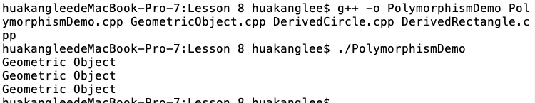
PolymorphismDemo.cpp
#include <iostream>
#include "GeometricObject.h"
#include "DerivedCircle.h"
#include "DerivedRectangle.h"
using namespace std;
void displayGeometricObject(const GeometricObject& g)
{
cout << g.toString() << endl;
}
int main()
{
GeometricObject geometricObject;
displayGeometricObject(geometricObject);
Circle circle(5);
displayGeometricObject(circle);
Rectangle rectangle(4, 6);
displayGeometricObject(rectangle);
return 0;
}

Slide 18
Virtual Functions
Can you invoke the toString() function defined in Circle when executing displayGeometricObject(circle), the toString() function defined in Rectangle when executing displayGeometicObject(rectangle), and the toString() function defined in GeometricObject when executing displayGeometricObject(geometricObject)?
You can do so simply by declaring toString as a virtual function in the base class GeometricObject.

Slide 19
Define Virtual Functions
To enable dynamic binding for a function, you need to do two things:
The function must be defined virtual in the base class.
The variable that references the object for the function must contain the address of the object.
The toString() function in GeometricObject is now defined virtual.

Slide 20
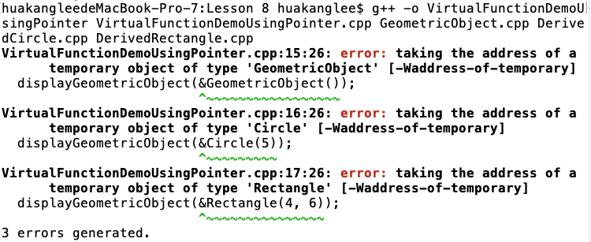
VirtualFunctionDemoUsingPointer.cpp
#include <iostream>
#include "GeometricObject.h" // toString() is defined virtual now
#include "DerivedCircle.h"
#include "DerivedRectangle.h"
using namespace std;
void displayGeometricObject(const GeometricObject* g)
{
cout << (*g).toString() << endl;
}
int main()
{
displayGeometricObject(&GeometricObject());
displayGeometricObject(&Circle(5));
displayGeometricObject(&Rectangle(4, 6));
return 0;
}

Slide 21
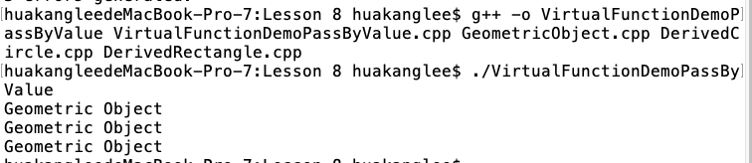
VirtualFunctionDemoPassByValue.cpp
#include <iostream>
#include "GeometricObject.h"
#include "DerivedCircle.h"
#include "DerivedRectangle.h"
using namespace std;
void displayGeometricObject(GeometricObject g)
{
cout << g.toString() << endl;
}
int main()
{
displayGeometricObject(GeometricObject());
displayGeometricObject(Circle(5));
displayGeometricObject(Rectangle(4, 6));
return 0;
}

Slide 22
Note
If a function is defined virtual in a base class, it is automatically virtual in all its derived classes.
It is not necessary to add the keyword virtual in the function declaration in the derived class.

Slide 23
static matching vs. dynamic binding
Matching a function signature and binding a function implementation are two separate issues.
The declared type of the variable decides which function to match at compile time.
The compiler finds a matching function according to parameter type, number of parameters, and order of the parameters at compile time.
A virtual function may be implemented in several derived classes. C++ dynamically binds the implementation of the function at runtime, decided by the actual class of the object referenced by the variable.

Slide 24
use virtual functions?
If a function defined in a base class needs to be redefined in its derived classes, you should declare it virtual to avoid confusions and mistakes.
On the other hand, if a function will not be redefined, it is more efficient without declaring it virtual, because it takes more time and system resource to bind virtual functions dynamically at runtime.

Slide 25
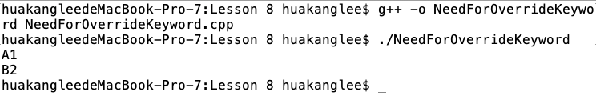
The override and final keywords
#include <iostream>
using namespace std;
class A
{
public:
virtual void print(int i)
{
cout << "A" << i << endl;
}
};
class B : public A
{
public:
// Suppose to override the print function in A
virtual void print(long i)
{
cout << "B" << i << endl;
}
};
int main()
{
A* p1 = new B();
B* p2 = new B();
p1->print(1);
p2->print(2);
return 0;
}
NeedForOverrideKeyword.cpp

Slide 26
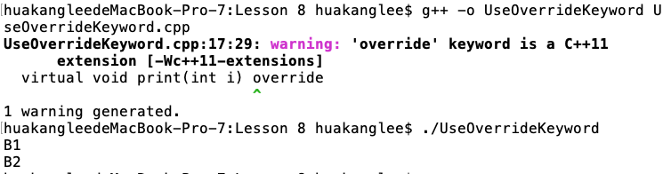
UseOverrideKeyword.cpp
#include <iostream>
using namespace std;
class A
{
public:
virtual void print(int i)
{
cout << "A" << i << endl;
}
};
class B : public A
{
public:
// Use override keyword to avoid errors
virtual void print(int i) override
{
cout << "B" << i << endl;
}
};
int main()
{
A* p1 = new B();
B* p2 = new B();
p1->print(1);
p2->print(2);
return 0;
}

Slide 27
The protected Keyword
So far you have used the private and public keywords to specify whether data fields and functions can be accessed from the outside of the class.
Private members can only be accessed from the inside of the class and public members can be accessed from any other classes.
A protected data field or a protected function in a base class can be accessed by name in its derived classes.

Slide 28
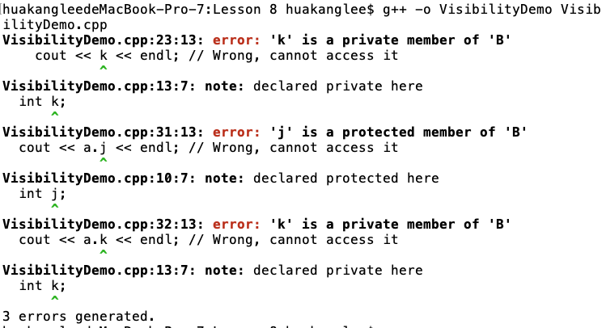
VisibilityDemo.cpp
#include <iostream>
using namespace std;
class B
{
public:
int i;
protected:
int j;
private:
int k;
};
class A: public B
{
public:
void display() const
{
cout << i << endl; // Fine, can access it
cout << j << endl; // Fine, can access it
cout << k << endl; // Wrong, cannot access it
}
};
int main()
{
A a;
cout << a.i << endl; // Fine, can access it
cout << a.j << endl; // Wrong, cannot access it
cout << a.k << endl; // Wrong, cannot access it
return 0;
}

Slide 29
Abstract Classes
In the inheritance hierarchy, classes become more specific and concrete with each new derived class.
If you move from a derived class back up to its parent and ancestor classes, the classes become more general and less specific.
Class design should ensure that a base class contains common features of its derived classes. Sometimes a base class is so abstract that it cannot have any specific instances.
Such a class is referred to as an abstract class.

Slide 30
Abstract Functions
Since you can compute areas and perimeters for all geometric objects, it is better to declare the getArea() and getPerimeter() functions in the GeometricObject class.
However, these functions cannot be implemented in the GeometricObject class because their implementation is dependent on the specific type of geometric object.
Such functions are referred to as abstract functions. After you declare the functions in GeometricObject, GeometricObject becomes an abstract class.

Slide 31
Abstract Class Example

Slide 32
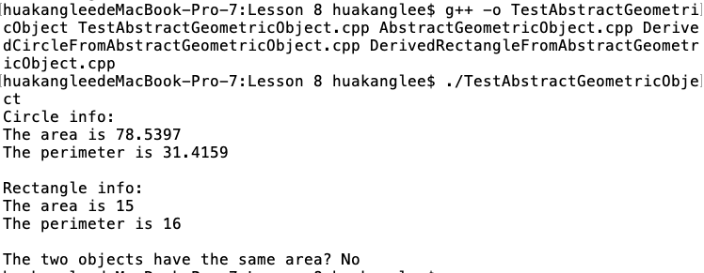
TestAbstractGeometricObject
AbstractGeometricObject.h
AbstractGeometricObject.cpp
DerivedCircleFromAbstractGeometricObject.h
DerivedCircleFromAbstractGeometricObject.cpp
DerivedRectangleFromAbstractGeometricObject.h
DerivedRectangleFromAbstractGeometricObject.cpp

Slide 33
Casting: static_cast versus dynamic_cast
The header for the displayGeometricObject function in Listing 15.19 is
void displayGeometricObject(const GeometricObject& object)
Suppose you wish to modify this function to display radius, diameter, area, and perimeter if the object is a circle. How can this be done?

Slide 34
Static Casting Example
void displayGeometricObject(GeometricObject& g)
{
cout << "The radius is " << g.getRadius() << endl;
cout << "The diameter is " << g.getDiameter() << endl;
cout << "The width is " << g.getWidth() << endl;
cout << "The height is " << g.getHeight() << endl;
cout << "The area is " << g.getArea() << endl;
cout << "The perimeter is " << g.getPerimeter() << endl;
}

Slide 35
Static Casting Example
void displayGeometricObject(GeometricObject& g)
{
GeometricObject* p = &g;
cout << "The raidus is " <<
static_cast<Circle*>(p)->getRadius() << endl;
cout << "The diameter is " <<
static_cast<Circle*>(p)->getDiameter() << endl;
cout << "The width is " <<
static_cast<Rectangle*>(p)->getWidth() << endl;
cout << "The height is " <<
static_cast<Rectangle*>(p)->getHeight() << endl;
cout << "The area is " << g.getArea() << endl;
cout << "The perimeter is " << g.getPerimeter() << endl;
}

Slide 36
Dynamic Casting Example
You can use the dynamic_cast operator to cast a parameter of the GeometricObject type into a Circle type, and then invoke the getRadius() and getDiameter() functions defined in the Circle class, as shown in the following code:
GeometricObject* p = &object;
Circle* p1 = dynamic_cast<Circle*>(p);
if (p1 != 0)
{
cout << "The radius is " << p1->getRadius() << endl;
cout << "The diameter is " << p1->getDiameter() << endl;
}

Slide 37
Upcasting and Downcasting
Assigning a pointer of a derived class type to a pointer of its base class type is called upcasting and assigning a pointer of a base class type to a pointer of its derived class type is called downcasting.

Slide 38
Upcasting and Downcasting
Upcasting can be performed implicitly without using the dynamic_cast operator. For example, the following code is correct:
GeometricObject *p = new Circle(1);
Circle *p1 = new Circle(2);
p = p1;
However, downcasting must be performed explicitly. For example, to assign p to p1, you have to use
p1 = dynamic_cast<Circle*>(p);

Slide 39
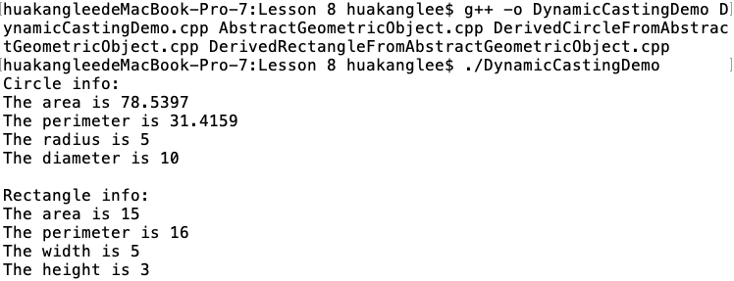
DynamicCastingDemo.cpp
#include "AbstractGeometricObject.h"
#include "DerivedCircleFromAbstractGeometricObject.h"
#include "DerivedRectangleFromAbstractGeometricObject.h"
#include <iostream>
using namespace std;
// A function for displaying a geometric object
void displayGeometricObject(GeometricObject& g)
{
cout << "The area is " << g.getArea() << endl;
cout << "The perimeter is " << g.getPerimeter() << endl;
GeometricObject* p = &g;
Circle* p1 = dynamic_cast<Circle*>(p);
Rectangle* p2 = dynamic_cast<Rectangle*>(p);
if (p1 != NULL)
{
cout << "The radius is " << p1->getRadius() << endl;
cout << "The diameter is " << p1->getDiameter() << endl;
}
if (p2 != NULL)
{
cout << "The width is " << p2->getWidth() << endl;
cout << "The height is " << p2->getHeight() << endl;
}
}
int main()
{
Circle circle(5);
Rectangle rectangle(5, 3);
cout << "Circle info: " << endl;
displayGeometricObject(circle);
cout << "\nRectangle info: " << endl;
displayGeometricObject(rectangle);
return 0;
}

Slide 40
Static vs. Dynamic Casting
dynamic_cast can be performed only on the pointer or a reference of a polymorphic type; i.e., the type contains a virtual function.
dynamic_cast can be used to check whether casting is performed successfully at runtime. static_cast is performed at compile time.

Slide 41
typeid operator
Occasionally, it is useful to obtain the information about the class of the object. You can use the typeid operator to return a reference to an object of class type_info.
For example, you can use the following statement to display the class name for object x.
string x;
cout << typeid(x).name() << endl;
It displays string, because x is an object of the string class.

Slide 42
templates and inheritance
A nontemplate class can be derived from a class template specialization.
A class template can be derived from a nontemplate class.
A class template can be derived from a class template.

Slide 43
summarization
Derived Classes
Class Constructors
Constructor Chaining
Destructor Chaining
Polymorphism
Virtual Functions
Protected Keyword
Abstract

Slide 44



THANK YOU
Visit us
FOLLOW us
www.xjtlu.edu.cn
Notes:
Title: Uppercase, Calibri size 60, XJTLU Navy

